Slide 1

CSE 321b
Computer Organization (2)
تنظيم الحاسب (2)
3rd year, Computer Engineering
Winter 2017
Lecture #8
Dr. Hazem Ibrahim Shehata
Dept. of Computer & Systems Engineering
Credits to Dr. Ahmed Abdul-Monem Ahmed for the slides

Slide 2
Adminstrivia
Assignment #2:
Due: Thursday, April 13, 2017
Midterm:
Date: Saturday, April 15, 2017
Time: 10:30am – 12:00pm
Location: classroom #27309
Coverage: lectures #1 ➔ #6
Website: http://hshehata.github.io/courses/zu/cse321b/
Office hours: TBA

Slide 3
Chapter 10. Computer Arithmetic (Cont.)

Slide 4
Outline
Integer Representation
Sign-Magnitude, Two’s Complement, Biased
Integer Arithmetic
Negation, Addition, Subtraction
Multiplication, Division
Floating-Point Representation
IEEE 754
Floating-Point Arithmetic
Addition, Subtraction
Multiplication, Division
Rounding

Slide 5
Multiplication Example
المضروب
المضاعِف
Running addition.
1 ➔ add & shift
0 ➔ shift only
الناتج
Complex (relative to addition)!!
Work out a partial product for each digit.
Shift the partial product appropriately.
Add partial products.
Generate double-length result.

Slide 6
Unsigned Binary Multiplication
Initially 0
Initially 0
Product

Slide 7
Flowchart for Unsigned Binary Multiplication

Slide 8
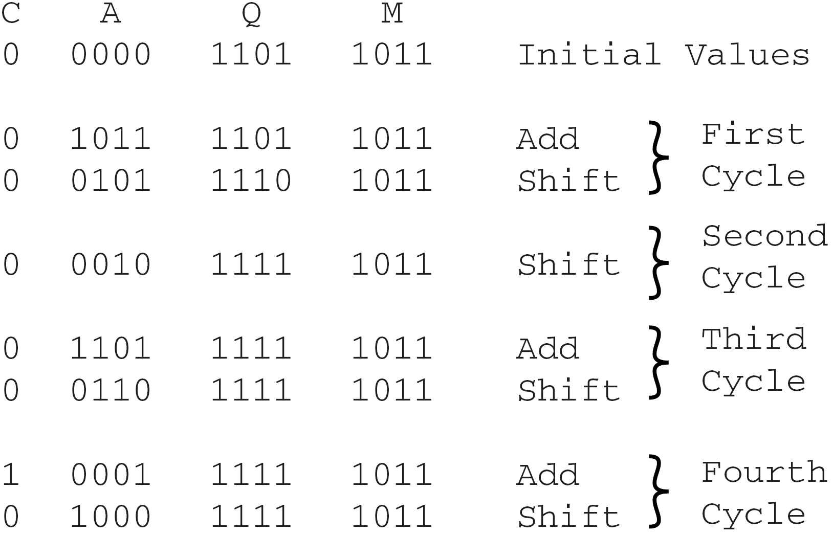
Execution of Example
Product (143)

Slide 9
Signed Binary Multiplication
The straight forward multiplication algorithm doesn’t work with signed numbers!!
Evidence: In the previous example, suppose that M & Q are interpreted as signed numbers:
M = (1011)₂ which represents (-5)₁₀
Q = (1101)₂ which represents (-3)₁₀
Applying the algorithm results in a product value of (1000 1111)₂ which represents (-113)₁₀
This result is wrong! Correct value is supposed to be (+15)₁₀!!!!

Slide 10
Signed Multiplication Algorithm #1
Convert multiplicand (M) & multiplier (Q) to their absolute (positive) values |M| & |Q|.
Run the unsigned multiplication algorithm on |M| & |Q| to obtain the final product (P).
Adjust the sign of P (by 2’s complementation where needed) according to the following rule:
sign(P) = sign(M) X sign(Q)

Slide 11
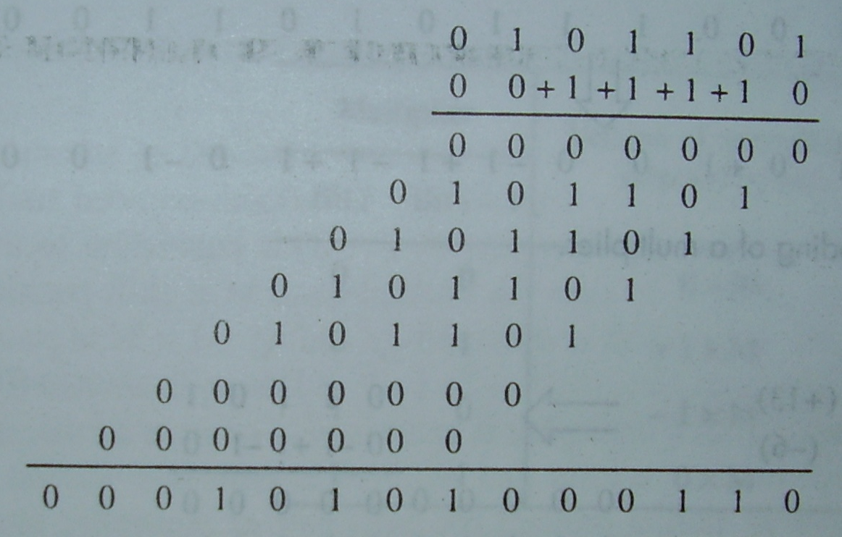
Signed Multiplication Algorithm #2 (Booth’s Algorithm)
0 1 0 1 1 0 1
X 0 0 1 1 1 1 0
Multiplier
Multiplier
0 1 0 0 0 0 0
– 0 0 0 0 0 1 0
0 +1 0 0 0 –1 0

Slide 12
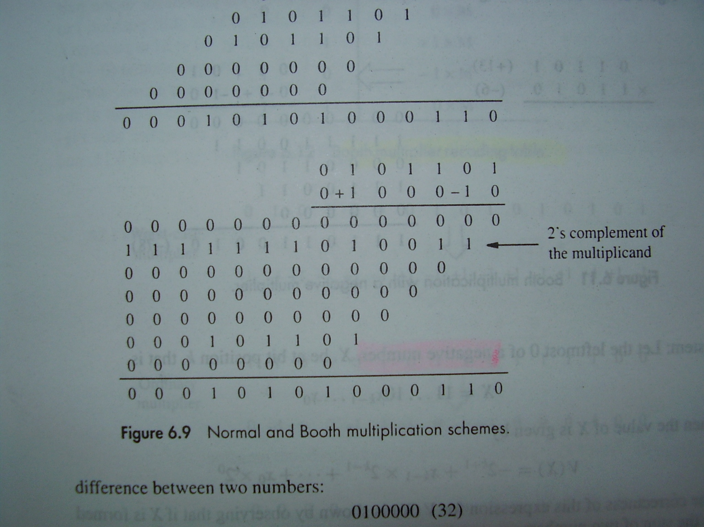
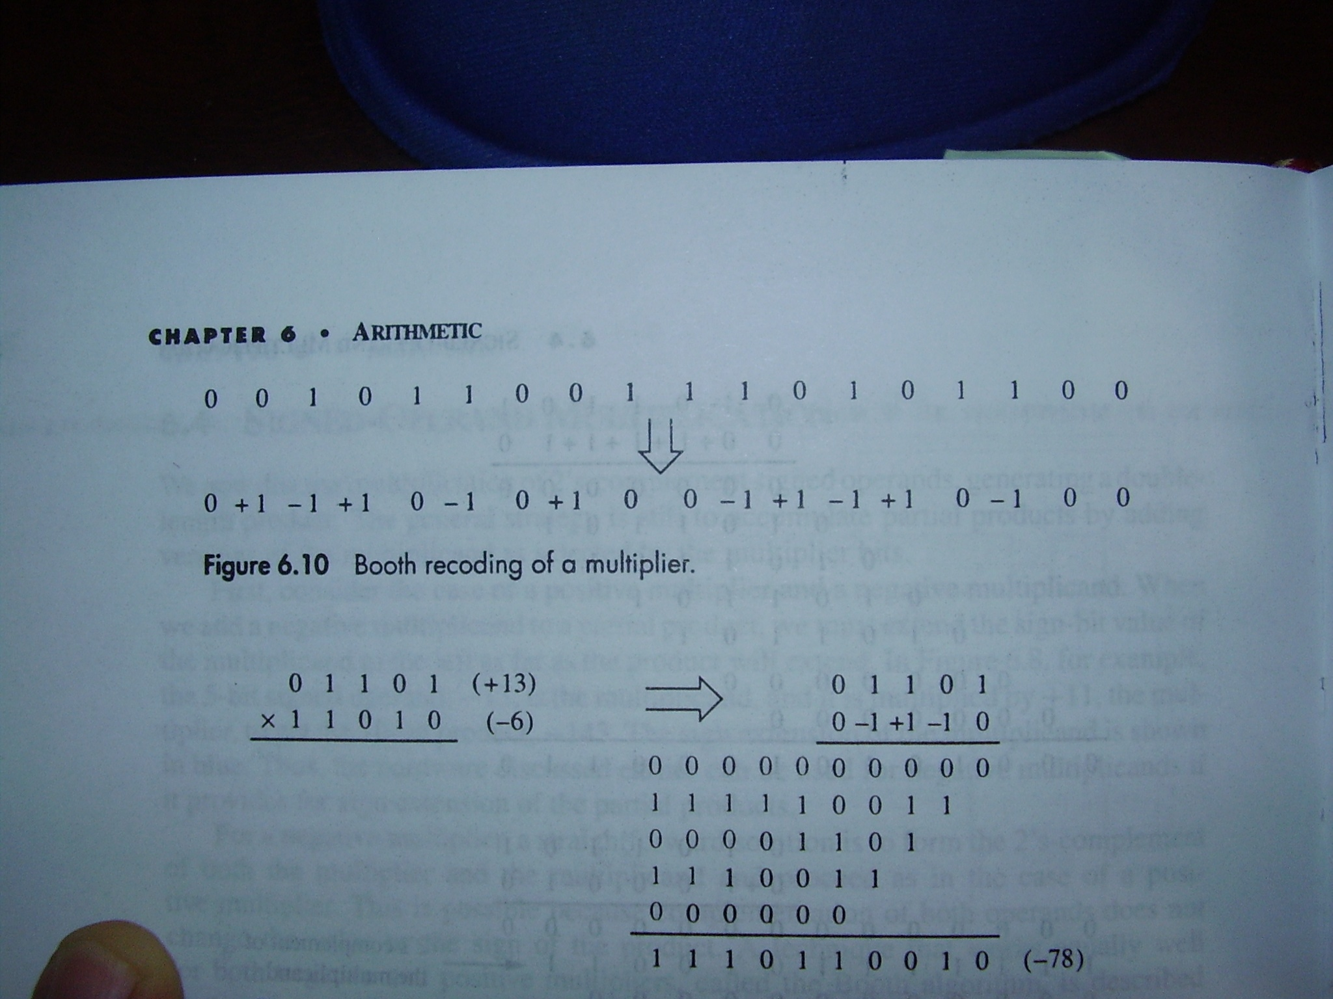
Booth's Algorithm – Example
2’s complement of
the multiplicand

Slide 13
Booth's Algorithm – Rule
Multiplier Bit i Bit i–1 | Version of multiplicand selected by bit i
0 0 | 0 × M
0 1 | +1 × M
1 0 | –1 × M
1 1 | 0 × M

Slide 14
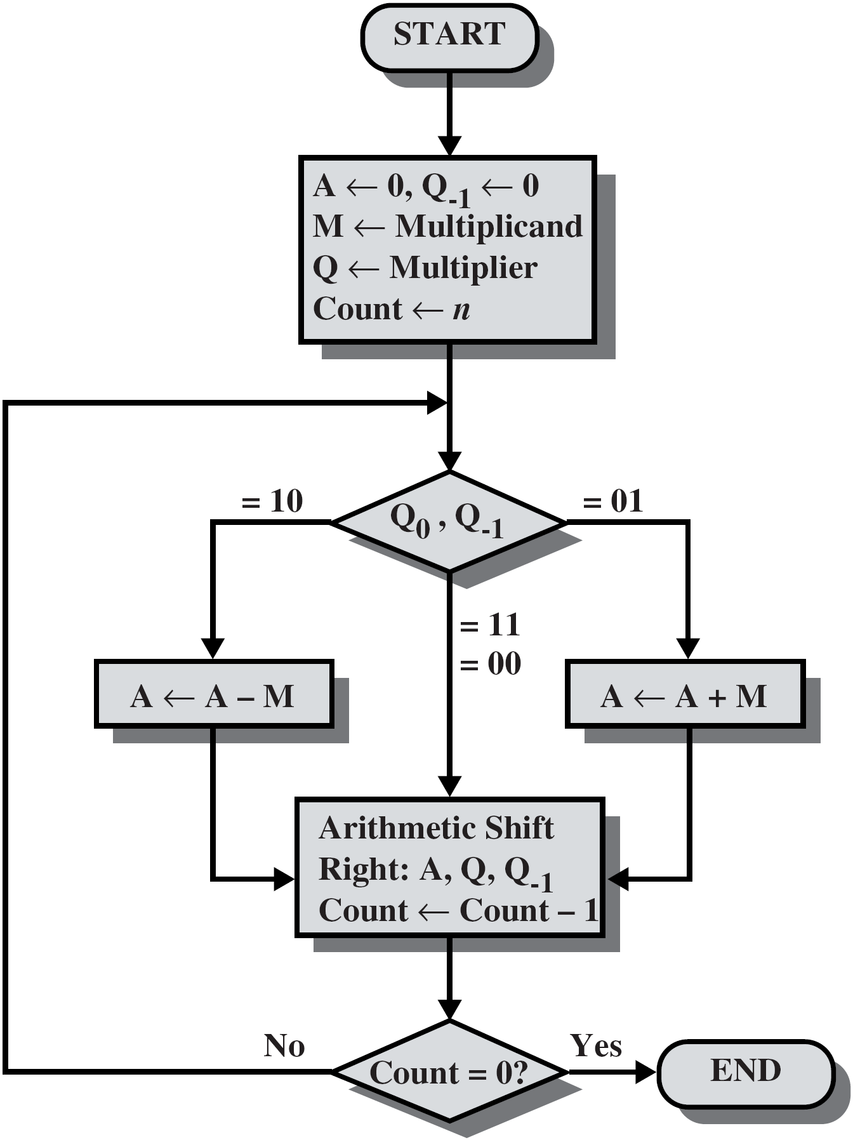
Booth’s Algorithm Flowchart

Slide 15
Example on Booth’s Algorithm
Product (21)

Slide 16
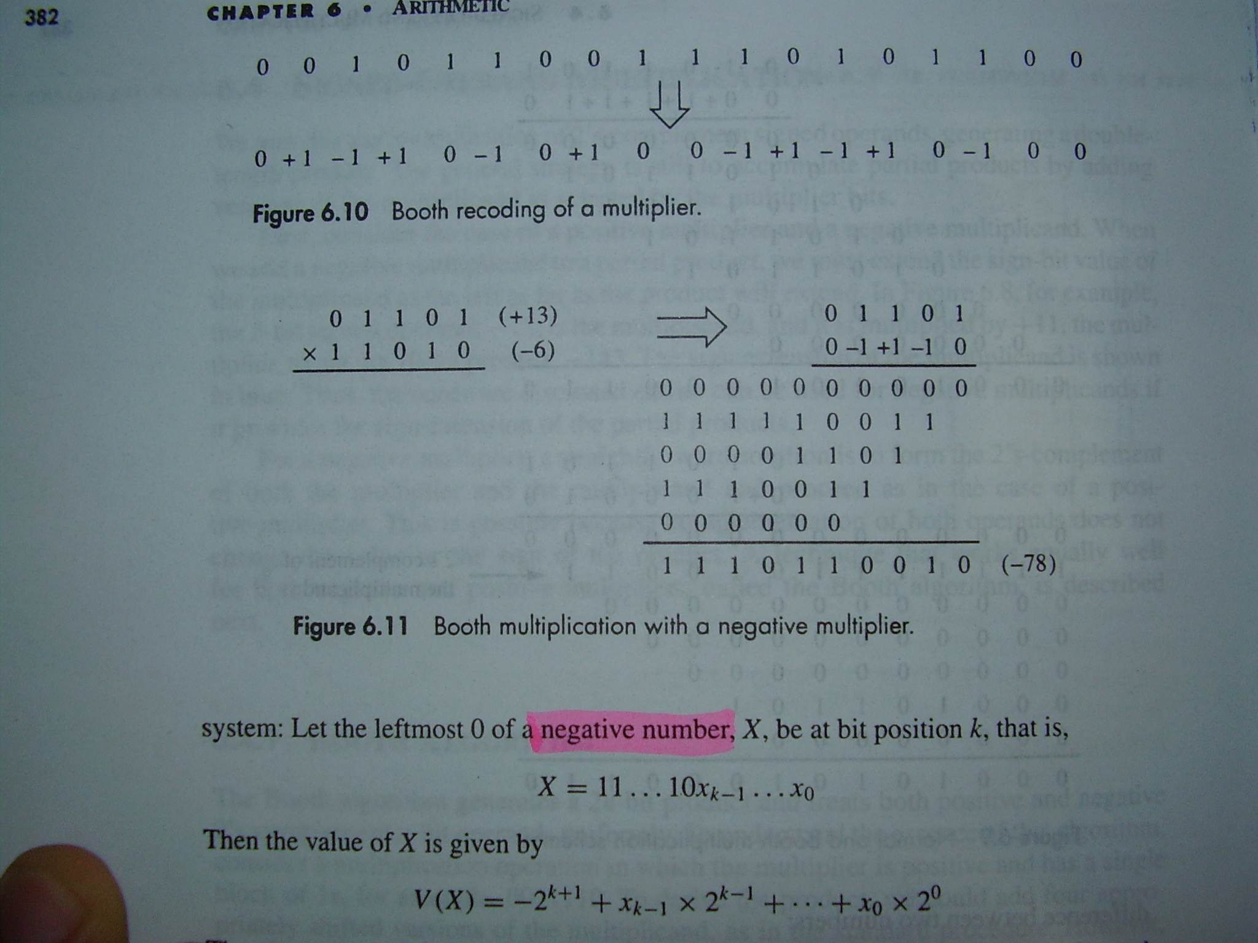
Booth's Algorithm, –ve Multiplier

Slide 17
Booth’s Algorithm - Cases
Worst-case
Multiplier
0 | 1 | 0 | 1 | 0 | 1 | 0 | 1 | 0 | 1 | 0 | 1 | 0 | 1 | 0 | 1
+1 | -1 | +1 | -1 | +1 | -1 | +1 | -1 | +1 | -1 | +1 | -1 | +1 | -1 | +1 | -1
Ordinary
Multiplier
1 | 1 | 0 | 0 | 0 | 1 | 0 | 1 | 1 | 0 | 1 | 1 | 1 | 1 | 0 | 0
0 | -1 | 0 | 0 | +1 | -1 | +1 | 0 | -1 | +1 | 0 | 0 | 0 | -1 | 0 | 0
Good
Multiplier
0 | 0 | 0 | 1 | 1 | 1 | 1 | 1 | 0 | 0 | 0 | 0 | 0 | 1 | 1 | 1
0 | 0 | +1 | 0 | 0 | 0 | 0 | -1 | 0 | 0 | 0 | 0 | +1 | 0 | 0 | -1
Booth’s Algorithm – Pros:
Treats +ve and –ve multipliers uniformly.
Use fewer additions if the multiplier has large blocks of 1’s.
On average, has the same efficiency as the normal algorithm.

Slide 18
Division
More complex than multiplication.
Negative numbers are really bad!
Based on long division.
الحاصل
القاسم
المقسوم
الباقي

Slide 19
Restoring Division (Positive Integers)
Divisor
M_{n-1}
· · ·
M₀
A←A–M
A_{n-1}
· · ·
A₀
Q_{n-1}
· · ·
Q₀
000…0
Dividend
Restore
Remainder
Quotient
Quotient in Q
Remainder in A

Slide 20
Restoring Division Example
First cycle
7/3
Second cycle
Third cycle
Fourth cycle
Quotient
Remainder

Slide 21
Non-Restoring Division (Positive Integers)
START
A ← 0
M ← Divisor
Q ← Dividend
Count ← n
No
A < 0 ?
Yes
Shift Left A,Q
A ← A – M
Shift Left A,Q
A ← A + M
No
A < 0 ?
Yes
Q₀ ← 1
Q₀ ← 0
Count ← Count – 1
No
Count = 0 ?
Yes
No
A < 0 ?
Yes
A ← A + M
Quotient in Q
Remainder in A
END

Slide 22
Non-Restoring Division Example
A | Q |  | M = 0011
0000 | 0111 |  | Initial Values
0000 | 111? |  | Shift
1101 | 111? |  | Subtract
1101 | 1110 |  | Q₀ ← 0
1011 | 110? |  | Shift
1110 | 110? |  | Add
1110 | 1100 |  | Q₀ ← 0
1101 | 100? |  | Shift
0000 | 100? |  | Add
0000 | 1001 |  | Q₀ ← 1
0001 | 001? |  | Shift
1110 | 001? |  | Subtract
1110 | 0010 |  | Q₀ ← 0
0001 | 0010 |  | Add
A | Q |  | M = 0011
0000 | 0111 |  | Initial Values
0000 | 111? |  | Shift
1101 | 111? |  | Subtract
1101 | 1110 |  | Q₀ ← 0
1011 | 110? |  | Shift
1110 | 110? |  | Add
1110 | 1100 |  | Q₀ ← 0
1101 | 100? |  | Shift
0000 | 100? |  | Add
0000 | 1001 |  | Q₀ ← 1
0001 | 001? |  | Shift
1110 | 001? |  | Subtract
1110 | 0010 |  | Q₀ ← 0
0001 | 0010 |  | Add
First cycle
Second cycle
7/3
Third cycle
Fourth cycle
Remainder
Quotient

Slide 23
Dealing with Signed Integers
Given a dividend (D) and divisor (V) where both are signed integers in the 2’s complement representation.
Division can be carried out as follows:
Convert D & V to their absolute (+ve) values |D| & |V|.
Run either restoring or non-restoring division on |D| & |V| to obtain the quotient (Q) and the remainder (R).
Adjust the sign of Q and R (by 2’s complementation where needed) according to the following rules:
sign(Q) = sign(D) X sign(V)
sign(R) = sign(D)

Slide 24
Reading Material
Stallings, Chapter 10:
Pages 331 – 341

